Slide 1
Alessi, Lucia, and Carsten Detken. "Identifying excessive credit growth and leverage."
Journal of Financial Stability 35 (2018): 215-225.
유재은
2021.08.29

Slide 2
Introduction
Global financial crisis
Credit Growth
System risk
(financial stability)
Early warning model
Identify period(excessive leverage rate)
Warrant policy action

Slide 3
Introduction
Two stream of this paper
Investigate the role of credit growth and leverage as a cause of ﬁnancial crises.
→ Credit growth is a good predictor of ﬁnancial crises (in particular of banking crisis)
2. Create a model for early warning indicators.
Studies have shown to be better early warning indicator for credit-related systemic banking crises than many domestic variables.
(The debt service ratio, bank credit developments and house prices)

Slide 4
Concept of banking crises and macroprudential policy
Banking crises often occurred deregulation or the asymmetric information problem.
Relevant indicators or warning signals to trigger the use of that particular policy instrument.
The extension of loans to more risky borrowers
2. Focus on a speciﬁc set of banking crises which have been associated with a domestic credit cycle
→ The credit cycle, the (sectoral) countercyclical capital bufferinstruments targeting borrowers like loan-to-value and loan-to- income ratios.
The warning signals obtained by the Random Forest approach
Weakness)
There will be crises unrelated to any patterns observed in the past.
There will be some for which the model has not been devised to predict.
→ Identifying vulnerable states of banking sectors, which could trigger speciﬁc macroprudential policy instruments

Slide 5
The banking crises dataset
Euro area countries together with the UK, Denmark and Sweden
Excluded Central and Eastern European transition economies(data series are relatively short)
From 1970Q1 till 2013Q4
25 separate crisis episodes are recorded for euro area countries, the UK, Denmark and Sweden.
(Detken, C., Weeken, O., Alessi, L., Bonﬁm, D., Boucinha, M.M., Castro, C., Frontczak, S., Giordana, G., Giese, J., Jahn, N., Kakes, J., Klaus, B., Lang, J.H., Puzanova, N., Welz, P., 2014. Operationalizing the Countercyclical Capital Buffer. ESRB Occasional Paper, no. 5.)

Slide 6
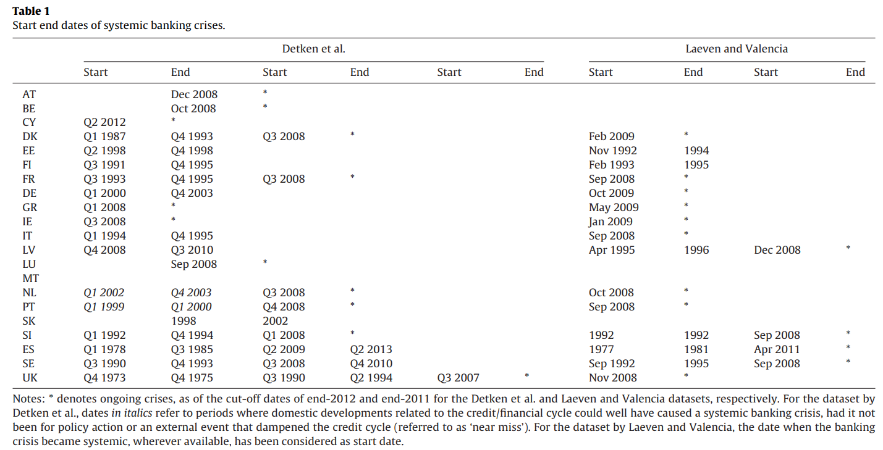
The banking crises dataset
recorded in the dataset by Laeven and Valencia. while they are not in the dataset by Detken et al.
recorded in the dataset by Detken et al. while they are not in the dataset by Laeven and Valencia.

Slide 7
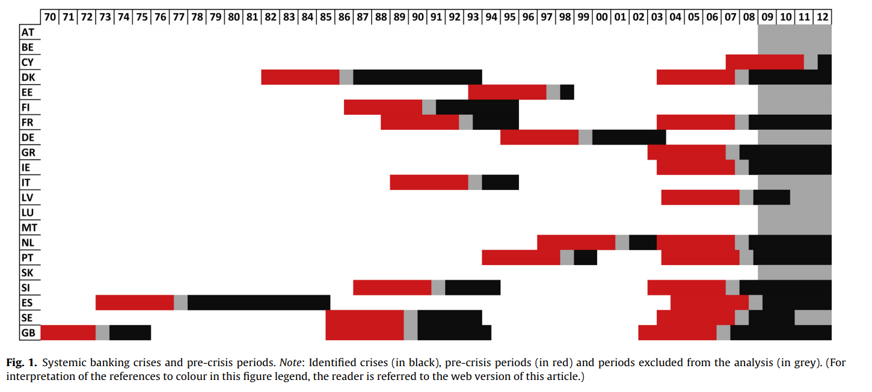
The banking crises dataset
Policy lags (for binary target)
We deﬁne as correct any warning signals issued in the four years preceding the start of a crisis, excluding from the analysis the three quarters immediately preceding the crisis and the crisis period itself.

Slide 8
Early warning indicators
Lag all the variables by one quarter.
→ The model aims at classifying the current quarter as pre-crisis or tranquil on the basis of data referring to no later than the last quarter
Credit-related indicators
Broad credit aggregate
(i) the y-o-y rate of growth (ii) the ratio to GDP
(iii) the deviations of such ratio from its trend (i.e. the ‘gap’)
Narrower bank credit aggregate
(i) credit to households and non-ﬁnancial corporations are transformed into y-o-y
rates of growth, deﬂated by CPI inﬂation, and ratios to GDP.
(ii) The real rate of growth of housing loans

Slide 9

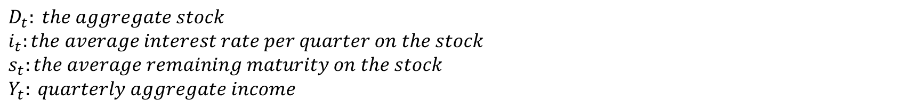
Early warning indicators
Global liquidity
Constructed by averaging the y-o-y broad credit growth rates across countries,
deﬂated by subtracting the y-o-y changes of the national CPI.
DSR
$$D_{t}: the aggregate stock$$
$$i_{t}:the average interest rate per quarter on the stock$$
$$s_{t}:the average remaining maturity on the stock$$
$$Y_{t}: quarterly aggregate income$$

Slide 10
Early warning indicators
2) Macroeconomic indicators
Real GDP y-o-y growth / The current account in percentage of GDP / The M3 money aggregate(in terms of real y-o-y rate of growth and gap) / the real effective exchange rate.
3) Property prices
House price growth (y-o-y, consumer price deﬂated) / The house price to income ratio and the house price to rent ratio
4) Market-based indicators
The long (10 years) and short (3 months) interest rates

Slide 11
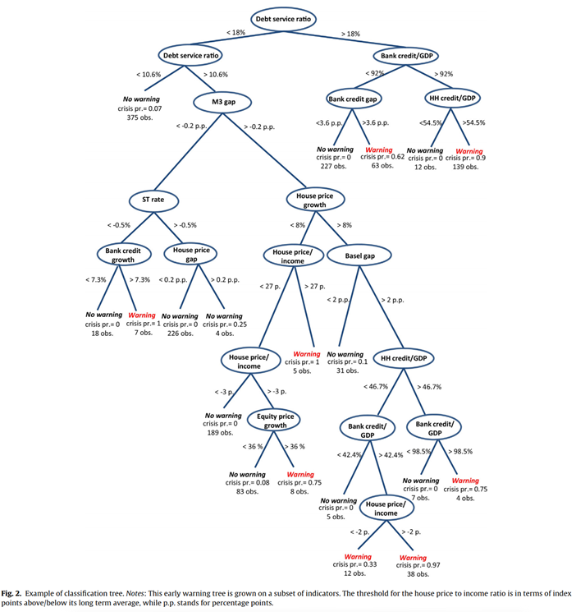
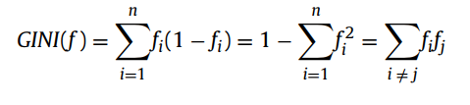

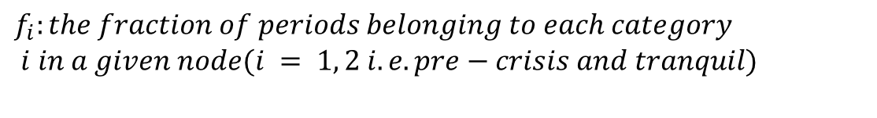
Classiﬁcation trees and the Random Forest
$$f_{i}:the fraction of periods belonging to each category$$
$i in a given node(i = 1, 2 i.e. pre−crisis and tranquil)$
generalize the above expression for the Gini index in order to take into account different misclassiﬁcation costs Cij for the various classes.

Slide 12
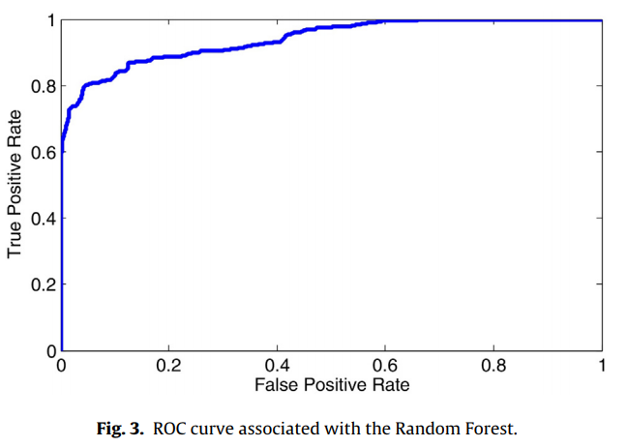
Classiﬁcation trees and the Random Forest
Based on the error rate of a 100,000-tree forest we have grown on all of the indi- cators, the chance of misclassifying an incoming quarter of data is 6%.
the ROC curve of the Random Forest, corresponding to an AUROC above 0.9 (0.94).

Slide 13

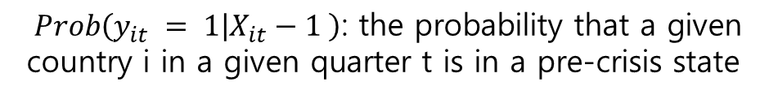
Comparison with logit models
Logistic Regressions
$$Prob\left(y_{it} = 1 | X_{it}−1 \right)\text{:} \text{the} \text{probability} \text{that} \text{a} \text{given} \text{country} \text{i} \text{in} \text{a} \text{given} \text{quarter} \text{t} \text{is} \text{in} \text{a} \text{pre}\text{-}\text{crisis} \text{state}$$

Slide 14
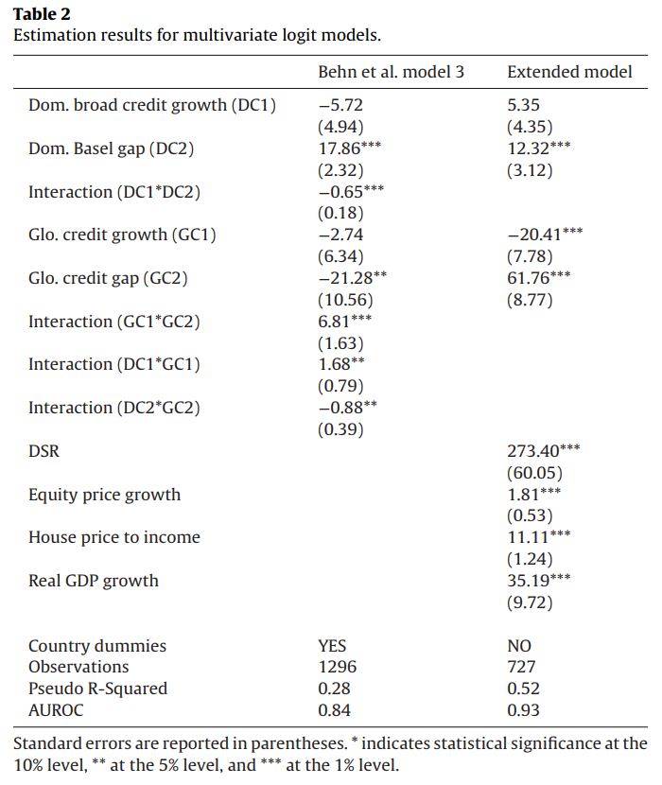
Comparison with logit models
Behn et al. model 3
requires dropping a number of countries (Cyprus, Estonia, Latvia, Luxembourg, Malta, Slovakia and Slovenia), and restricting the regressors to a handful of credit variables.
k-fold cross-validation on the logit regression.
→ logit AUROC of 0.86 (with a 95% conﬁdence interval between 0.84 and 0.88)
Extended model
requires restricting even further the number of countries considered, limiting them to Finland, France, Italy, the Netherlands, Sweden, Spain and the UK, while keeping observations as of 1980.
AUROC of 0.94 (with a 95% conﬁdence interval between 0.92 and 0.96)
restricting the sample to a handful of countries, 70’s ﬁnancial system was arguably quite different

Slide 15
Conclusions
Build an early warning system aiming at identifying whether the ﬁnancial system is particularly vulnerable owing to aggregate credit and asset price developments.
The increased likelihood and importance of a subsequent banking crisis would suggest to consider the implementation of macroprudential measures.
→ total credit to GDP deviations(‘Basel gap’)/ a policy guide(credit ratios, real estate indicators)/
global liquidity
Main advantages of the presented approach is that it takes into account the conditional relations between various indicators when setting early warning thresholds.
→ more accurately models the (nonlinear) relationship between credit, asset prices and the
occurrence of banking crises than standard regression models.

